Slide 1
Nature-based Solutions
Climate Walk: NbS for Development & Planning in Practice
May 2026

Slide 2
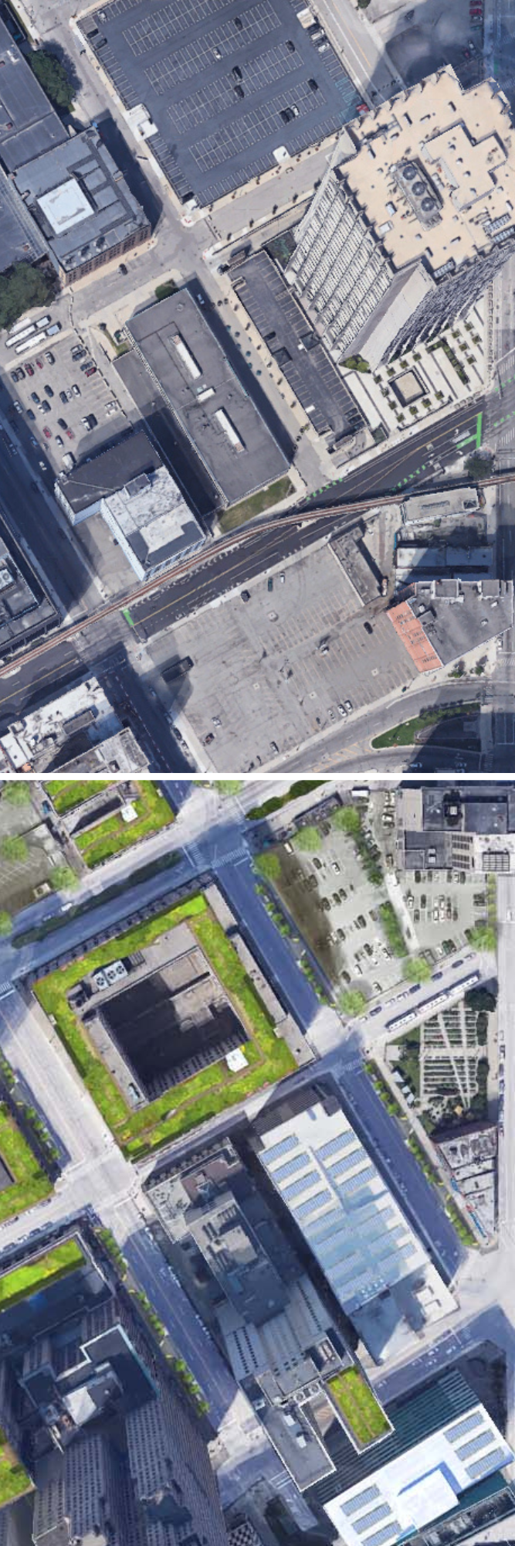
Urban Development
Cities can be more resource-efficient than rural areas per capita.
Yet cities are rarely rich in natural ecosystems and are often dominated by concrete, asphalt, and other “lifeless” surfaces.
Challenges such as stormwater runoff and flooding, urban heat islands, poor air quality, and reduced biodiversity highlight the need for effective urban management.
NbS can play a crucial role!

Slide 3

NbS Examples in Urban Spaces

Slide 4
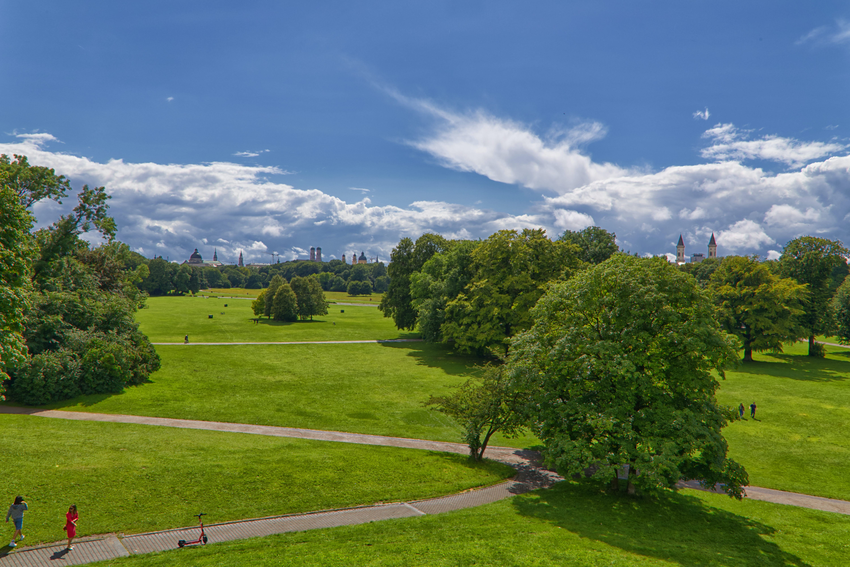
Urban Green Spaces
Improve air quality,
Contribute to temperature regulation,
Help with stormwater management,
Contribute to both mental and physical well-being.

Slide 5
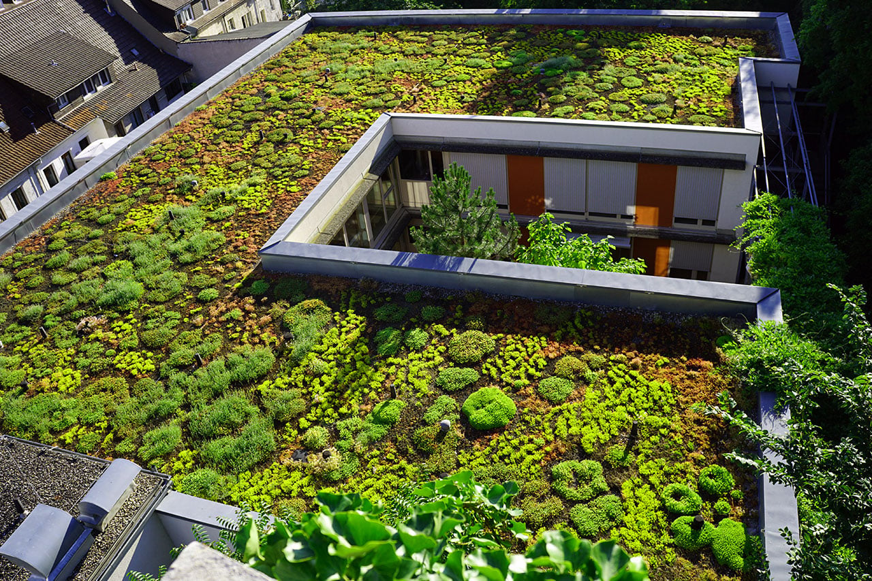
Green Roofs
Support stormwater retention,
Enhance energy efficiency,
Mitigate urban heat islands effects,
Improve air quality,
Promote biodiversity,
Reduce noise levels.

Slide 6
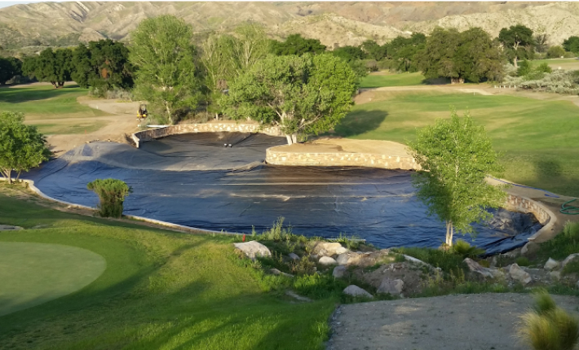
Retention Basins/Wet Ponds
Help reduce flood risk,
Improve water quality,
Create habitats that support biodiversity.

Slide 7

Insect-pollinated Vascular Plants
Enhance environmental quality,
Support pollinator populations,
Reduce pollution,
Provide essential ecosystem services for urban residents.

Slide 8
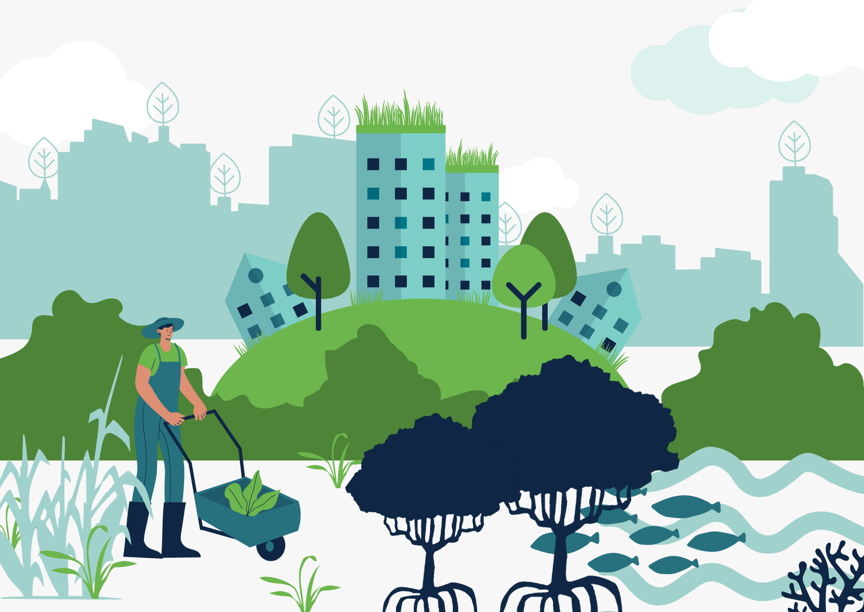
Implementation of NbS: Governance & Planning
Nbs implementation requires governance and planning practices rooted in stewardship, reflexivity, dialogue, and long-term commitment.
In urban setting, key success drivers are open innovation, partnerships among stakeholders, together with education and training.
Policymakers should strengthen policy frameworks across the full NbS cycle while ensuring environmental justice.

Slide 9
References
Hölscher, K., Frantzeskaki, N., Collier, M. J., Connop, S., Kooijman, E. D., Lodder, M., McQuaid, S., Vandergert, P., Xidous, D., Bešlagić, L., Dick, G., Dumitru, A., Dziubała, A., Fletcher, I., Adank, C. G-E., Vázquez, M. G., Madajczyk, N., Malekkidou, E., Mavroudi, M. (…), Vos, P. (2023). Strategies for mainstreaming nature-based solutions in urban governance capacities in ten European cities. Urban Sustainability, 3. https://doi.org/10.1038/s42949-023-00134-9
Karamoutsou, L., Veliou, E., Kvernberg, E. B., & Psilovikos, A. (2024). Urban Stormwater Management: A Sustainable Approach. Water, 16(15). https://doi.org/10.3390/w16152089
Li, Y., Zhai, W., Yang, Z., Tang, J., Li, H., & Huang, H. (2024). A review of nature-based solutions to environmental hazards through the lens of environmental justice. SSRN. http://dx.doi.org/10.2139/ssrn.4724771
Meyer, W. B. (2013). The Environmental Advantages of Cities: Countering Commonsense. https://doi.org/10.7551/mitpress/9513.001.0001
Oberndorfer, E., Lundholm, J., Bass, B., Coffman, R., Doshi, H., Dunnett, N., Gaffin, S., Köhler, M., Liu, K., & Rowe, B. (2007). Green Roofs as Urban Ecosystems: Ecological Structures, Functions, and Services. BioScience, 57. https://doi.org/10.1641/B571005
Perivoliotis, D., Arvanitis, I., Tzavali, A., Papakostas, V., Kappou, S., Andreakos, G., Fotiadi, A., Paravantis, J. A., Souliotis, M., & Mihalakakou, G. (2023). Sustainable Urban Environment through Green Roofs: A Literature Review with Case Studies. Sustainability, 15(22). https://doi.org/10.3390/su152215976

Slide 10
References
Phelan, P., Kaloush, K., Miner, M., Golden, J., Phelan, B., Silva, H., & Taylor, R. (2015). Urban heat island: Mechanisms, implications, and possible remedies. Annual Review of Environment and Resources, 40. https://doi.org/10.1146/annurev-environ-102014-021155
Shahmohammad, M., Hosseinzadeh, M., Dvorak, B., Bordbar, F., Shahmohammadmirab, H., & Aghamohammadi, N. (2022). Sustainable green roofs: a comprehensive review of influential factors. Environmental Science and Pollution Research. https://doi.org/10.1007/s11356-022-23405-x
Skaldina, O., Nylund, A., & Ramula, S. (2024). Neglected puzzle pieces of urban green infrastructure: richness, cover, and composition of insect-pollinated plants in traffic-related green spaces. Landscape Ecology, 39. https://doi.org/10.1007/s10980-024-01881-5
United Nations (n.d.) 68% of the world population projected to live in urban areas by 2050, says UN. https://www.un.org/uk/desa/68-world-population-projected-live-urban-areas-2050-says-un
Zhang, X., Brandt, M., Tong, X., Ciais, P., Yue, Y., Xiao, X., Zhang, W., Wang, K., & Fensholt, R. (2022). A large but transient carbon sink from urbanization and rural depopulation in China. Nature Sustainability 5, 321–328. https://doi.org/10.1038/s41893-021-00843-y

Slide 11

A Climate Walk…

