Slide 1
Nature-based Solutions
A Walk Through a Public Green Space: Designing Habitats for Humans and Wildlife
May 2026

Slide 2
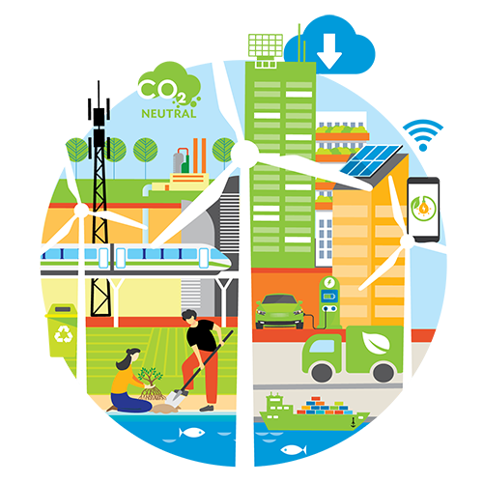
Nature-based Solutions (NbS)
Use ecosystems and the services they provide to address societal challenges (e.g., climate change, food security, natural disasters).
For solutions to work with ecosystems rather than relying on conventional engineering interventions, to adapt and mitigate climate change effects.
Can often be used in conjugation with other intervention types.

Slide 3
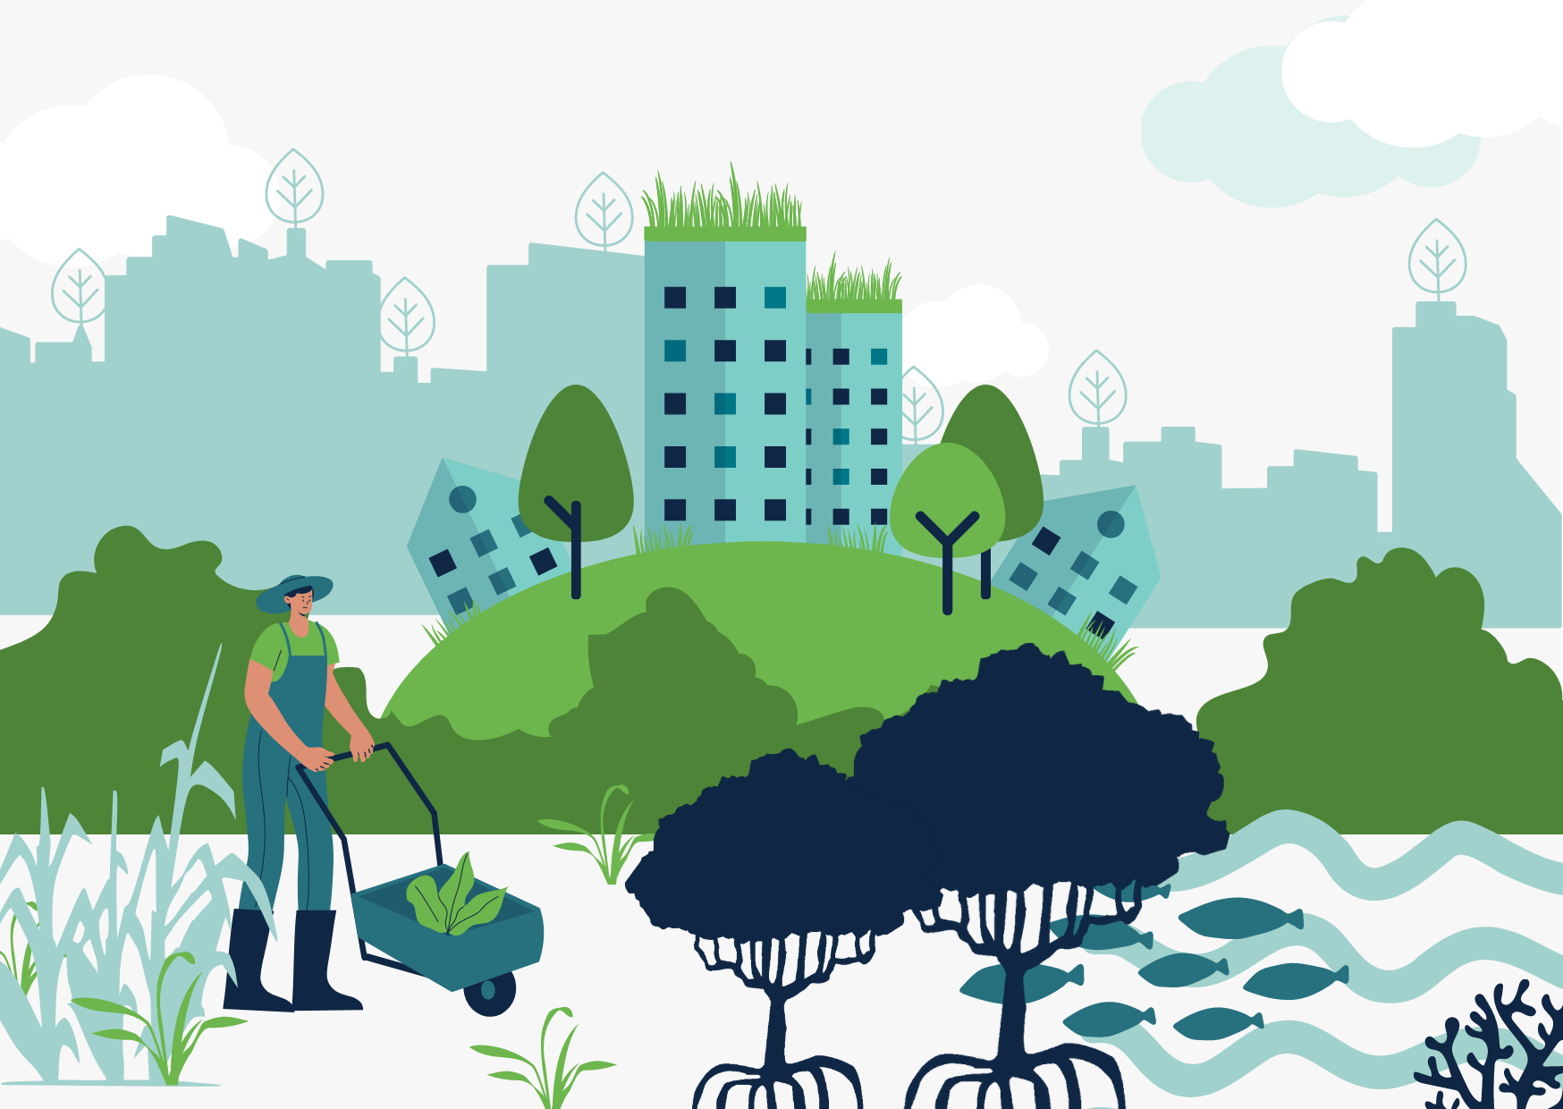
Nature-based Solutions (NbS)
Nature relates to biodiversity (species, habitats, ecosystems) and/or ecosystem services.
Nature-based refers to ecosystem approaches, or direct utilization of elements of biodiversity.
Solutions refers to a specific problem or challenge for which some recognizable solution or more beneficial outcome exist.
Definitions
“Actions to protect, sustainably manage, and restore natural or modified ecosystems, that address societal challenges effectively and adaptively, simultaneously providing human well-being and biodiversity benefits.” (IUCN, 2016)
“Actions inspired by, supported by or copied from nature and which aim to help societies address variety of environmental, social and economic challenges in sustainable ways.” (European Commission, 2015)

Slide 4
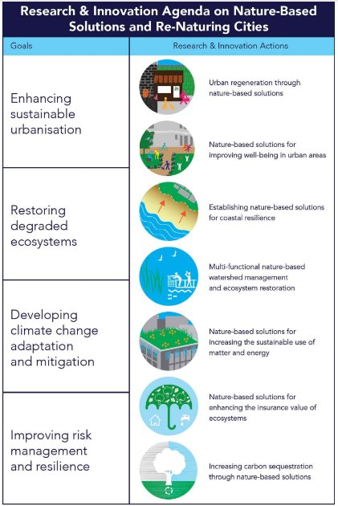
NbS Goals
European Commission, 2015

Slide 5

NbS Examples

Slide 6
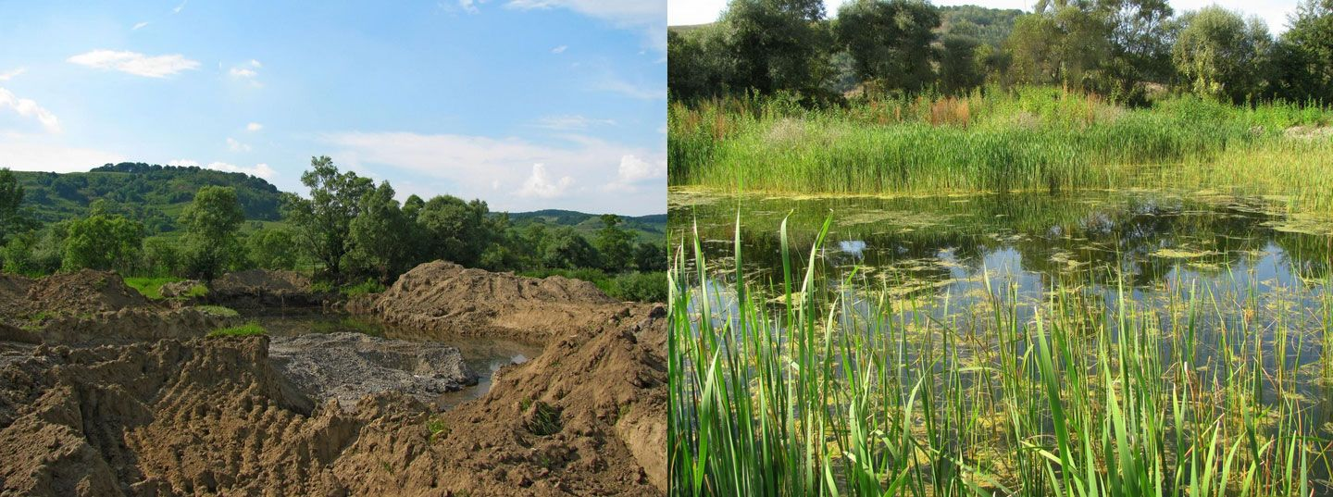
Ecosystem Restoration
Reforestation and replantation of native vegetation to restore degraded landscapes.
Restoration of wetlands to improve water quality and biodiversity.
Regeneration of coral reefs and revitalization of depleted fisheries.
Rewilding of landscapes with key species in restoring and maintaining the structure and function of ecosystems.

Slide 7

Ecosystem Protection
Conservation of undisturbed semi-natural areas to maintain their ecological integrity and the services they provide.
Establishment of protected areas to preserve wilderness and conserve biodiversity (e.g., Natura 2000 – EU’s network of protected sites that conserve Europe’s most valuable species and habitats).
Restoration of degraded peatland ecosystems to mitigate climate-related challenges.
Indigenous land tenure systems, empowerment of local communities in natural resource management through initiatives.
Notes:
If desired, in this slide it is possible to make a link to the next section of the course (“A Walk Through a Public Green Space”), especially Station 1- Biodiversity: “Who lives here and why?” about biodiversity, identifying various plant and animal species, and habitat provision.
A systems-thinking exercise can be introduced by posing questions such as: “If we mow less often, what changes?” or “If we plant trees in a specific area, who benefits and how?”. These guiding questions help students understand the interconnectivity of ecosystems by highlighting how a single change affects plants, animals, humans, and environmental processes. This prepares students for the walk, where they will observe these relationships in a real-world NbS context.

Slide 8
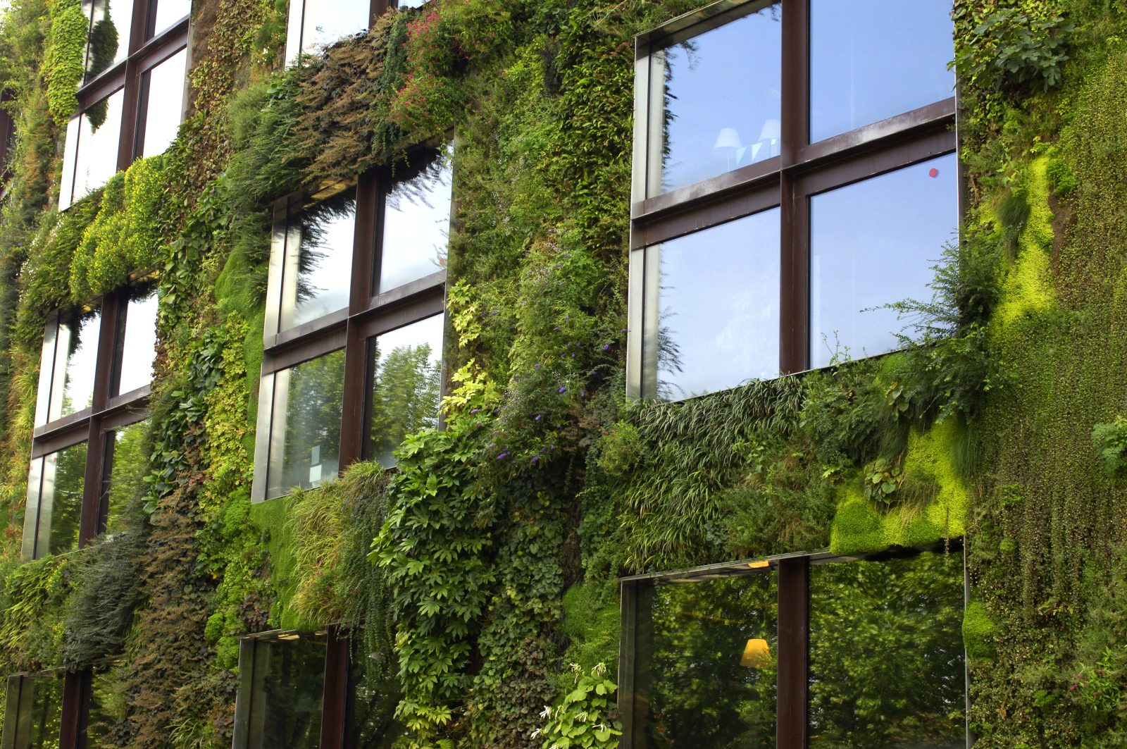
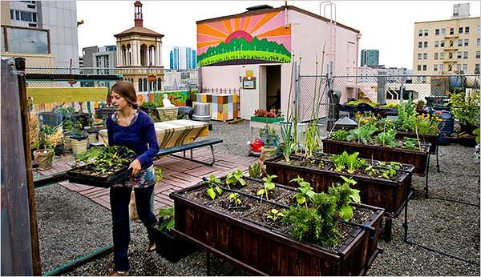
Green-blue Infra and Sustainable Urban Design
Design, planning and implementation of infra and systems that integrate natural elements, offering multiple benefits to humans and the environment.
Installation of green roofs and walls.
Permeable pavements to enhance water management.
Creating green corridors and spaces.
Community gardens.
Fostering human-nature interaction in urban settings.
Notes:
If desired, in this slide it is possible to make a link to the next section of the class (“A Walk Through a Public Green Space”), especially Station 2 - Water and soil: “What happens below our feet?”. Students will take part in a simple infiltration experiment that demonstrates how soil structure, vegetation cover, and compaction influence water absorption and retention. This helps illustrate how soil functions as a NbS for water management.

Slide 9
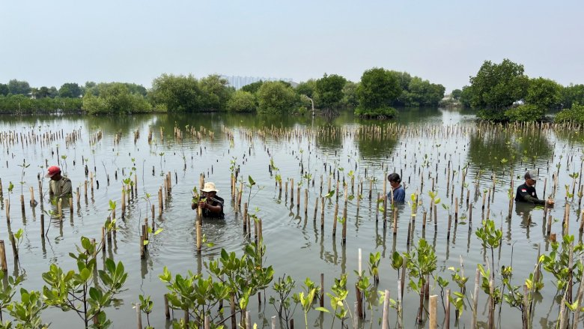
Ecosystem-based Approaches (EbA) & Ecosystem Disaster Risk Reduction (Eco-DDR)
EbA focus on climate-related hazards to slow-onset climate change impacts, such as sea level rise.
Agroecological methods to restore and maintain soil health and protect water resources.
Mangrove restoration and sustainable management of forests as climate change resilience strategies.
Notes:
If desired, in this slide it is possible to make a link to the next section of the class (“A Walk Through a Public Green Space”), especially Station 3: People and Climate: “Why this matters for humans”. For example, urban heat stress is a key climate impact addressed through EbA. By integrating trees and green spaces into urban areas, ecosystems provide shade, cooling, and improved thermal comfort, helping people adapt to rising temperatures in a nature-based way.

Slide 10
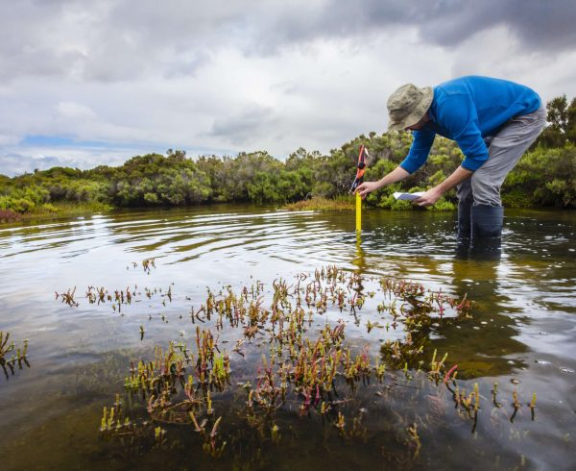
Ecosystem-based Approaches (EbA) & Ecosystem Disaster Risk Reduction (Eco-DDR)
Eco-DDR addresses both climate-related (e.g., heat waves) and non-climate hazards (e.g., earthquakes).
Restoration of coastal wetlands to mitigate coastal erosion and provide flood protection.
Maintenance of healthy ecosystems to reduce the likelihood and severity of wildfires and landslides on forested mountains and slopes (stabilizing sediments).
Notes:
If desired, in this slide it is possible to make a link to the next section of the class (“A Walk Through a Public Green Space”), especially Station 2 - Water and soil: “What happens below our feet?”. For example, flood risk can be reduced through Eco-DRR by using healthy soils and vegetation to absorb, store, and slow down water. These ecosystem functions reduce surface runoff and mitigate the impacts of heavy rainfall.

Slide 11
References
Eisenber, B., & Polcher, V. (2019). Nature Based Solutions -Technical Handbook. Personal Communication, 2020-02.
European Commission: Directorate-General for Research and Innovation (2015). Towards an EU research and innovation policy agenda for nature-based solutions & re-naturing cities – Final report of the Horizon 2020 expert group on 'Nature-based solutions and re-naturing cities' – (full version). Publications Office. https://data.europa.eu/doi/10.2777/765301
IUCN (2020). Global Standard for Nature-based Solutions. A user-friendly framework for the verification, design and scaling up of NbS. International Union for Conservation of Nature. https://portals.iucn.org/library/sites/library/files/documents/2020-020-En.pdf
Jones, M., Keryan, T., de Wit, M., & Klawitter, J. (2024). Comprehensive Overview of Nature-Based Solutions: Harnessing Nature for Environmental and Social Benefits. eNaBlS Project Consortium. https://enabls.eu/wp-content/uploads/2025/07/eNaBlS_A_comprehensive_overview_to_NBS_v1.0.pdf
Sowińska-Świerkosz, B., & García, J. (2022). What are Nature-based solutions (NBS)? Setting core ideas for concept clarification. Nature-Based Solutions, 2(100009). https://doi.org/10.1016/j.nbsj.2022.100009

Slide 12
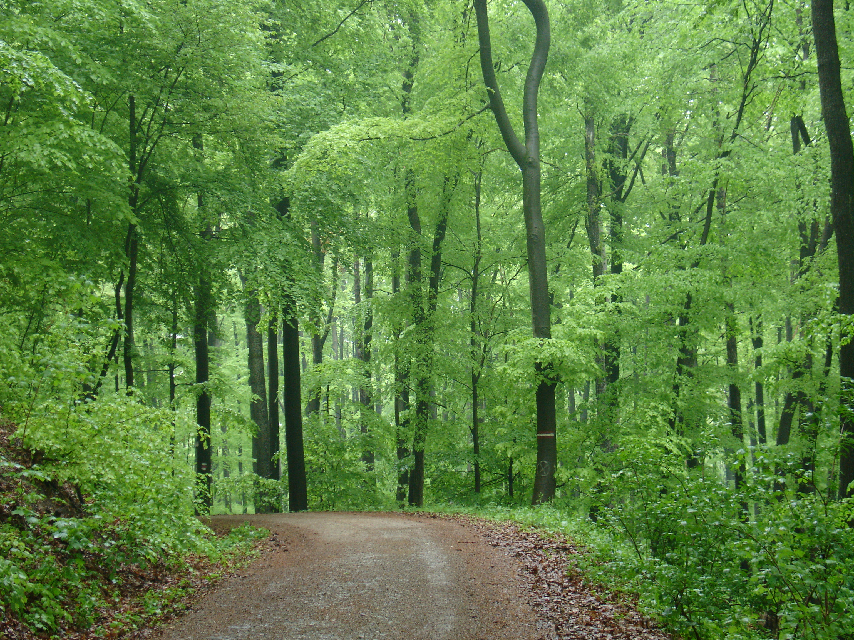
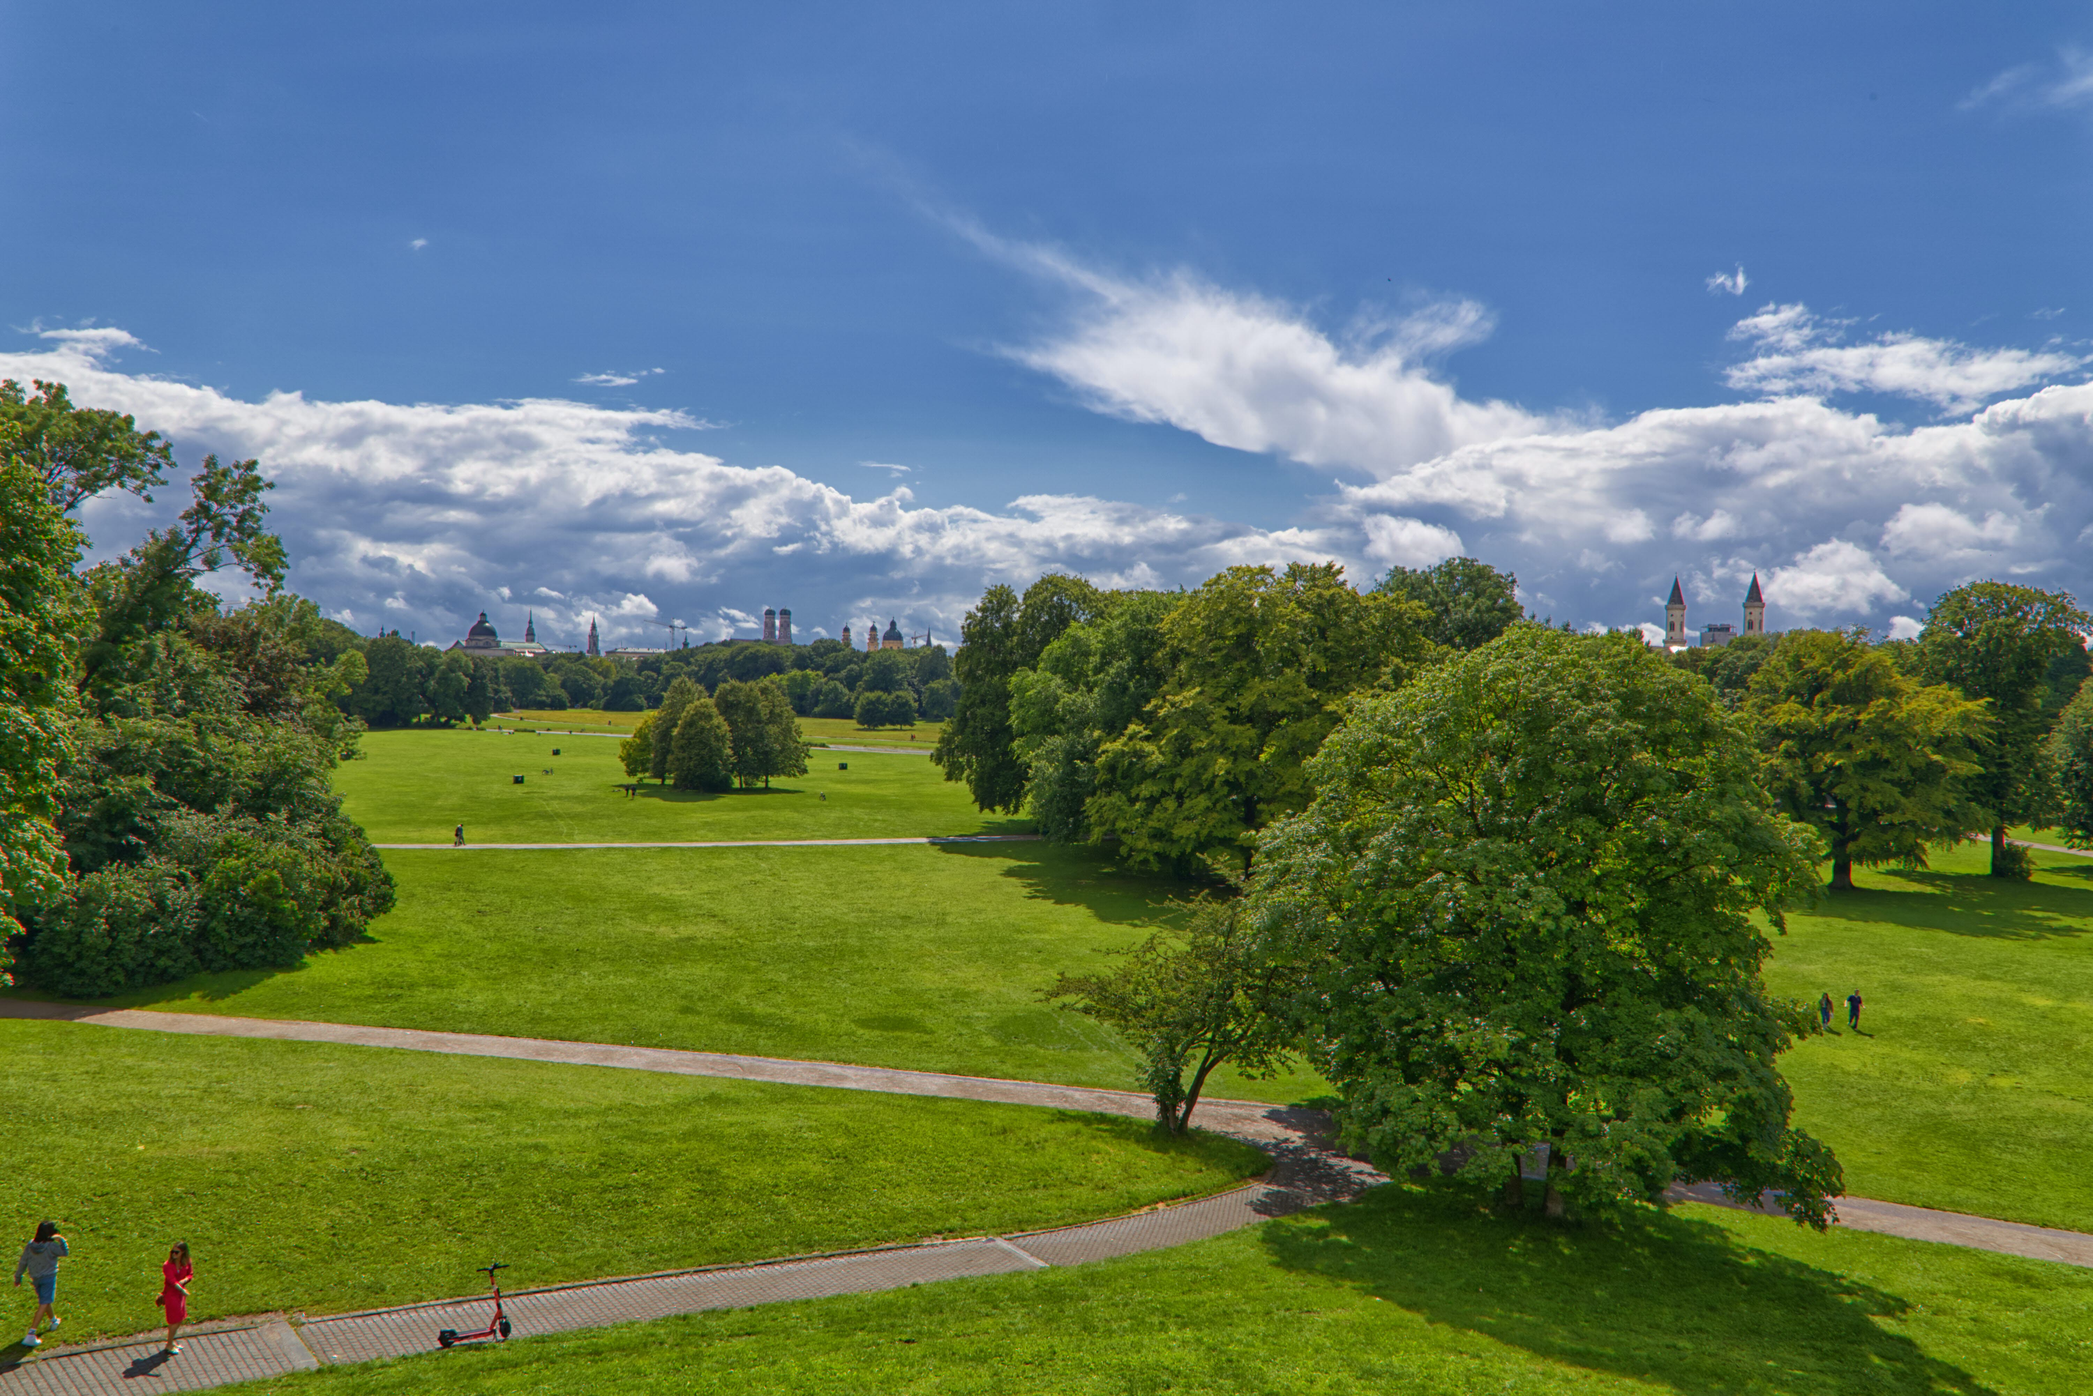
A Walk Through a Public Green Space…

